Slide 1
Sudoku Solver
Martin Rode
Marvin Üürike

Slide 2
Outline
Introduction
Approach
Results

Slide 3
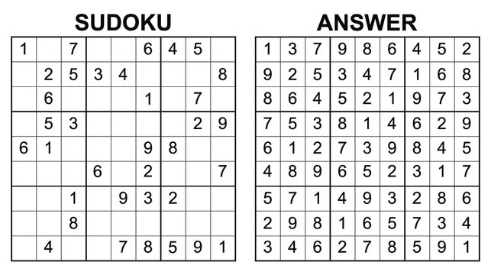
Introduction
HOW…

Slide 4
Approach
Depth First Search – lightweigh, suitable
Strategies:
Basic
Original Legal values
Updating Legal values with Cell Prioritization
Hidden singles with Cell Prioritization
Hidden singles and Naked Pairs with Cell Prioritization
Priority value search

Slide 5
Basic
Try values 1-9 for cells in row-by-row order
1 - check
2 - check
3 - check

Slide 6
Original Legal values
Try legal values for cells in row-by-row order
1 - check
2 - check
3 - check

Slide 7
Updating Legal values with Priority cell search
Updates all legal values each iteration and prioritizes cells with least legal values to try next
3 8 9
2 8 9
2 3 8
2 3 8
9
7
1 6
1 6

Slide 8
Hidden singles
Deep update of legal values cache
3 8 9
2 8 9
2 3 8
2 3 8
9
3 8 9
4 9
8 9
7
3

Slide 9
Naked pairs
Deep update cache when finding pairs
3 8 9
2 8 9
2 3 8
2 3 8
9
7
1 6
1 6
3 8 9
4 9
1 2 5 8
1 2 5 8
1 5
1 3 9
1 2 3
4 7 8
4 8 9
5 7
2 3 5 7 9
2 3

Slide 10
Priority value search
Try least frequent number first for cells
3 8 9
2 8 9
2 3 8
2 3 8
9
Which number?
3 8 9
4 9
2 count = 3
3 count = 5
4 count = 1
8 count = 6
9 count = 7
II
III
I
IV
8 9
V
7
3 7 9

Slide 11
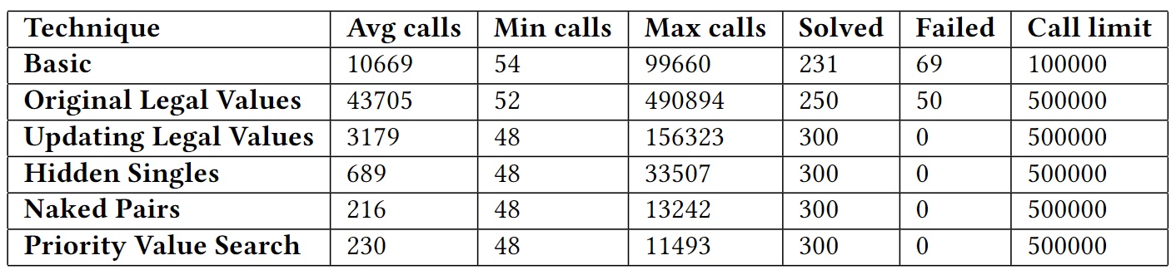
Results
All approaches were run on 300 “hard” sudokus and number of calls and total solving time was calculated.

Slide 12
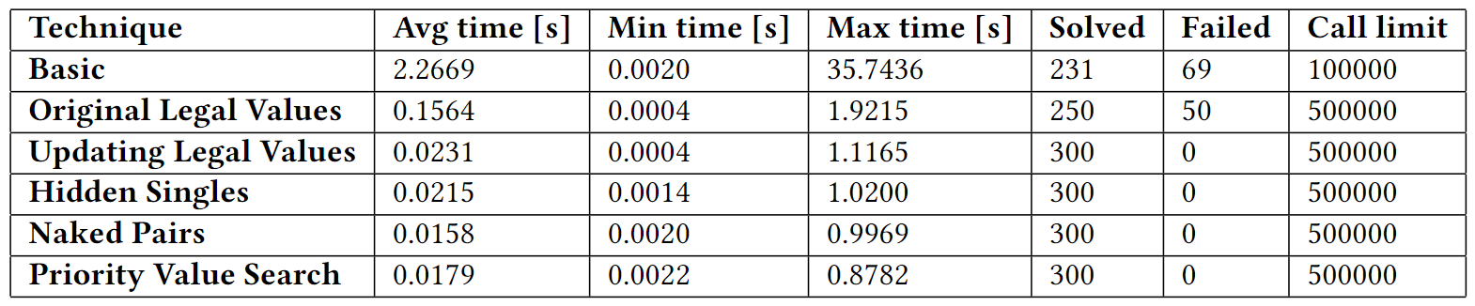
Results
All approaches were run on 300 “hard” sudokus and number of calls and total solving time was calculated.

Slide 13
Thank you!
Q&A

